Slide 1
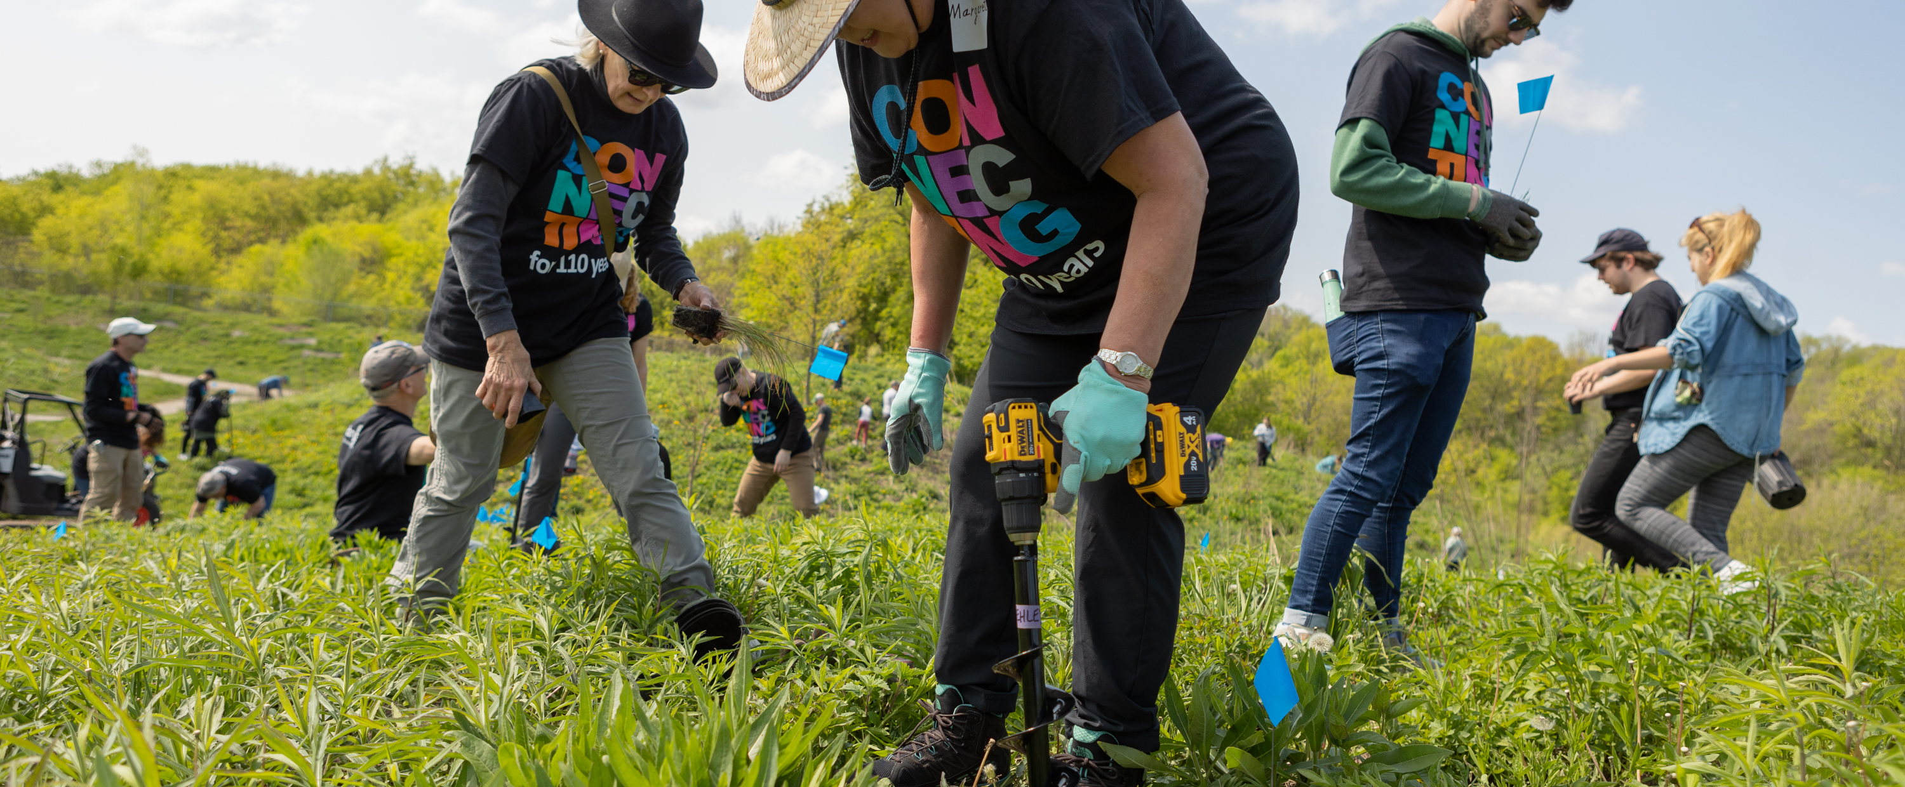

PETS Alliance – public Image Breakout
July 17-19 2024

Slide 2
subhead
Petina Dixon-Jenkins
Manager of Corporate Communications
Jean Saunders
Marketing Lead, Brand Experience
Liz Thiam
Global Advisor of Rotary Brand

Slide 3
subhead
Our Action Plan asks us to increase awareness of our impact and brand – by strengthening our public image.
What is public image?
What is Rotary’s public image?

Slide 4
subhead
We’re all Rotary brand ambassadors.
What does it mean to be a brand ambassador?
How can PETS inspire presidents-elect to tell stories of the impact they’re making?

Slide 5
subhead
Rotary provides resources to support members to tell their stories – on the Learning Center, on the Brand Center.
How will you promote Rotary’s public image resources into your PELs (PETs)?

Slide 6
subhead
Using Rotary branding correctly and consistently strengthens our brand.
How can we encourage clubs to use the Rotary branding correctly and consistently?

Slide 7
subhead
Brand consistency starts with leading by example.
How do we brand our own Multi-district PETS?

Slide 8
subhead
Some clubs are not using Rotary branding correctly.
How can PETs help encourage clubs to use correct branding?

Slide 9
subhead
Many clubs use the President’s Message in their communications.
How should clubs use the President’s Message during the Rotary year?
How do you use it?
What would make you more likely to use it?

Slide 10



Public Image Resources for PETS
Brand Center
Learning Center
Research Reports
rotary.org/brandcenter
learn.rotary.org
My Rotary
search: Rotary Research
brand guidance
videos/images – >1000
public image presentations - 11
public image courses - 6
public image learning plans
awareness & understanding - US
member survey

Slide 11
QUESTIONS

